Slide 1



Predicting Stock Movements with Natural Language Processing and Twitter
Kyle Johnson
Flatiron school final project

Slide 2

Methodology
Gather Data
Analyze Sentiment
Make Predictions

Slide 3
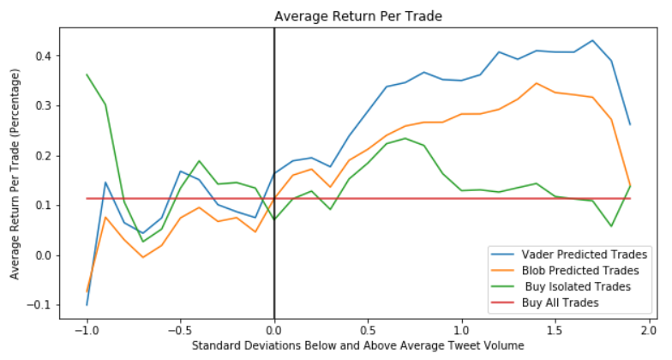
Findings: Abnormally high Tweet volume leads to improved trading results

Slide 4
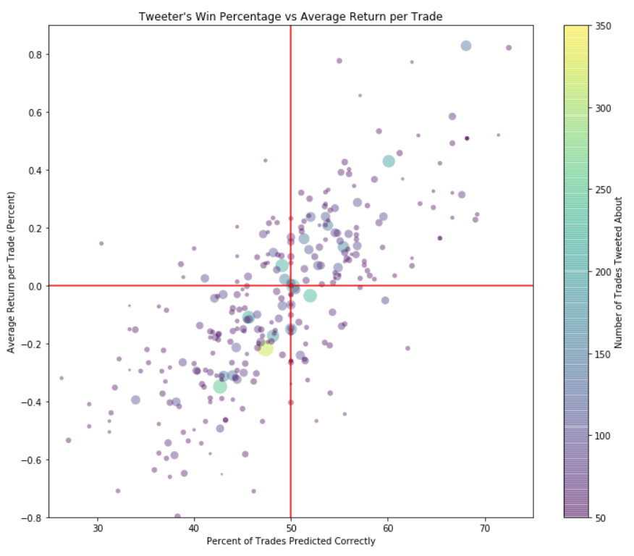
Findings: Some tweeters are better predictors than others

Slide 5
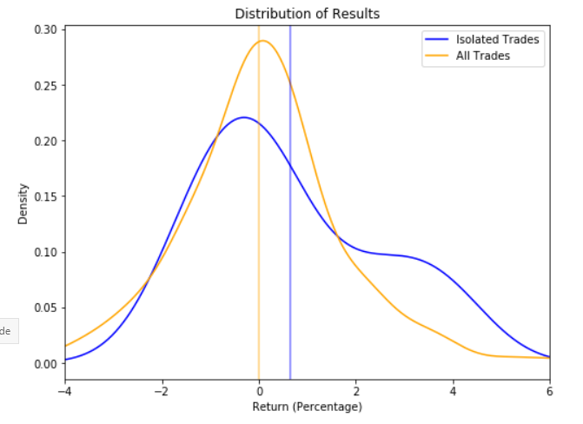
Findings: Isolating accurate tweeters can give useful predictions

Slide 6
Conclusions:
Natural Language Processing on stock market related tweets can provide useful insight into future stock movement
In general, the VADER algorithm outperformed the TextBlob algorithm
These techniques should not be used in real money trading because the data was mostly over three years old and did not contain examples from all market conditions

Slide 7
Future Work:
Purchase a Twitter Developer license to be able to run the same process for more recent data
Perform the same analysis on a wider array of stocks
Employ other sentiment analysis algorithms such as the one created by Google

